Slide 1
SOCIAL MEDIA MARKETING PLAN
Here is where your presentation begins
Aashika Arasu, Ali El-Tohamy, Ashley Hammond, Alexa Jarrett, Bridget Nelson, and Elika Shahriary
December 4, 2023 | MKTG 340 | Professor Nusrat
1/14
Notes:
ali

Slide 2
AGENDA
01
02
03
04
05
06
Company Overview
Company Analysis
5 Campaigns
What We Learned
Future Directions
Conclusion
2/14
Notes:
ali

Slide 3
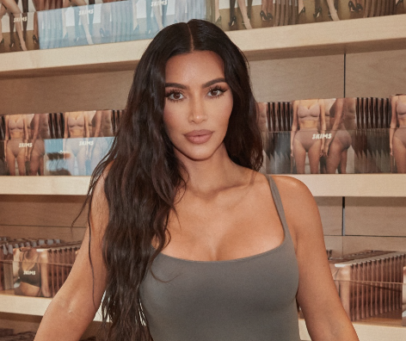
COMPANY OVERVIEW
“SKIMS is a solutions oriented brand creating the next generation of underwear, loungewear, and shapewear”
Owner: Kim Kardashian
Established: September 10, 2019
Current Value: $4 Billion
Target Audience: Women 18-45, Men 18-45
Top Competitors: Spanx, Victoria’s Secret, Savage X Fenty
Skims HQ: Los Angeles, CA
3/14
Notes:
Ellie

Slide 4
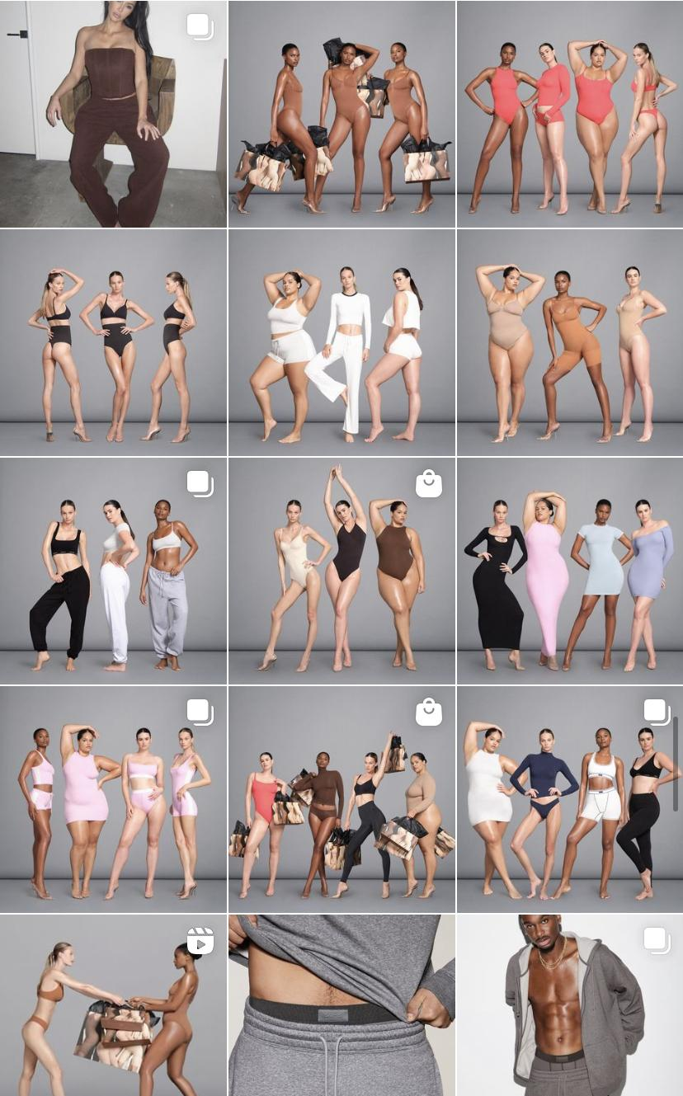
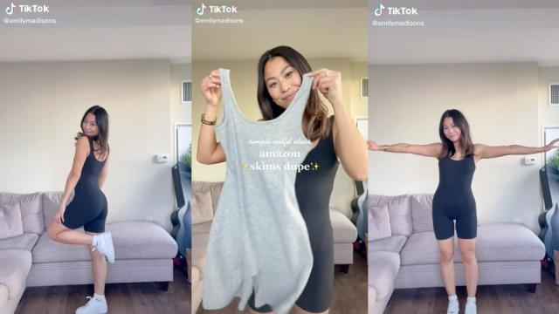
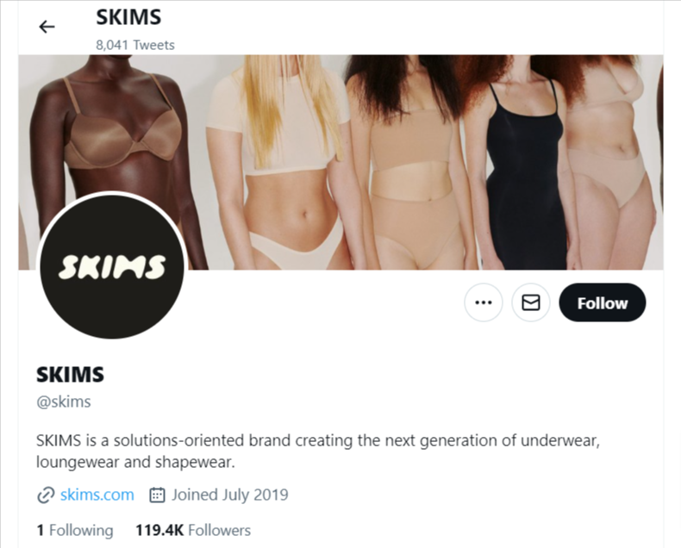
COMPANY ANALYSIS
Facebook (409k followers)
Avg 3 posts a day
Images
Twitter (121.8k followers)
Avg 3 posts a day
Images
Instagram (5.3m followers)
Avg 2 posts a day, with > 5 story posts
Images and Videos
Tiktok (1.2m followers)
1-2 posts a day
Videos
4/14
Notes:
Ashley
SKIMS main social media platforms are facebook, twitter, instagram and tiktok. Each platform posts daily and multiple times a day. When there is a big launch or new campaign taking place the average number of posts increase. Specifically on instagram all posts are professionally taken on models and hardly any writing on the post image. On the right is a screenshot of skims instagram feed. They are promoting their bi annual sale. You wouldn't know until you read the caption, because skims cares deeply about their cohesive and aesthetic feed. Another thing to point out is their second largest platform, Tiktok. Tiktok could use the most help considersing it is mainly user generated content. I would suggest commenting and interacting with the posts to encourage people buying from Skims and not the online dupes. Lastly, we have noticed SKIMS doesn’t take advantage of snapchat. Overall we believe they can strengthened their online presence by replying to comments, diving deeper into tiktok and utilizing snapchat.

Slide 5
5 CAMPAIGNS
5/14

Slide 6
SKIMLYMPICS
Objective: Expand International Presence of Skims Swimwear Line.
(Skims global exposure throughout Olympic duration)
Campaign Hashtag: #Skimlympics
Snapchat Ad with Olympic Swimmers
Start Date: ~3 weeks prior to the Paris '24 Olympics
Content: Collaborate with international Olympic swimmers
Execution: Ad showcasing Olympic athletes in Skims swimwear. Geofilters on Snap Maps across Paris at Olympic event locations.
Run the Snapchat ad continuously during the entire Olympic Games
Maximize visibility and engagement on a global scale
Monitor engagement metrics on Snapchat
Track hashtag usage across social media platforms
Measure brand awareness and swimwear sales during and post-campaign
6/14
Notes:
Aashika
For our first campaign - our primary goal is to Expand Skims' International Presence and showcase the versatility of the Swimwear line during the Paris '24 Olympics.
To achieve this, we have coined the hashtag #Skimlympics, symbolizing the union of Skims and the Olympics.
three weeks prior to the Paris '24 Olympics, our campaign revolves around a captivating Snapchat Ad featuring international Olympic swimmers proudly sporting Skims swimwear. This collaboration not only emphasizes the product's quality but also aligns it with the pinnacle of athletic excellence.
To maximize visibility, we will implement geofilters on Snap Maps, targeting Olympic event locations across Paris.
ensure the campaign's success, we will closely monitor engagement metrics on Snapchat, tracking user interactions and feedback. Simultaneously, we will analyze the usage of our campaign hashtag #Skimlympics across various social media platforms, creating a real-time dialogue with our global audience
evaluate the impact on skims swimwear sales during and post-campaign.

Slide 7
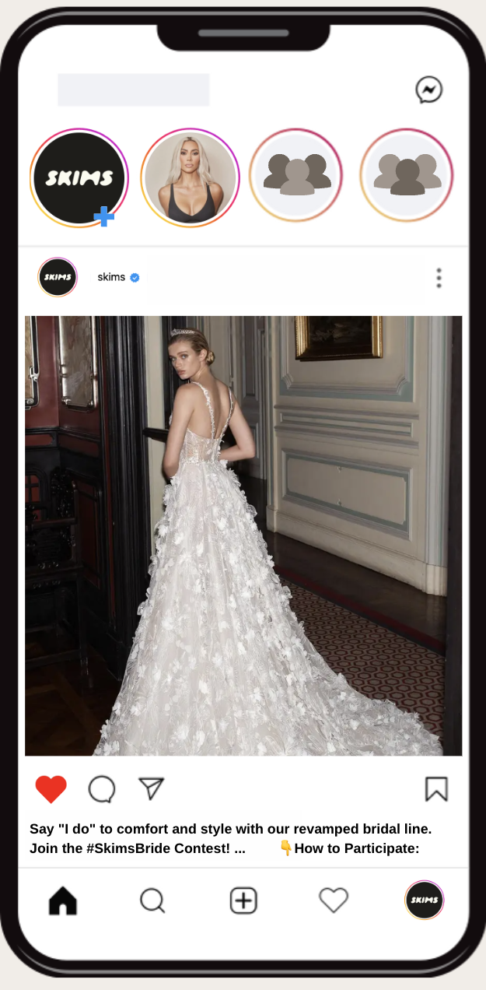
SKIMS BRIDE
Objective: Enhance Skims' bridal line with new products and marketing strategies.
Campaign Hashtag: #SkimsBride #SkimHoneymoon
Contest Engagement and Brand Promotion on Instagram & TikTok
Start Date: Launch one month prior to wedding season.
Teaser Phase: Utilize Instagram Stories and TikTok snippets for a week, to tease the upcoming bridal line revamp.
Content Kickoff: Begin Instagram/TicTok contest. Brides share BTS using #SkimsBride. Officially unveil the revamped bridal line.
Execution:
Use Instagram Live and TikTok for a virtual product showcase.
Encourage user-generated content by asking brides to share their favorite products using the campaign hashtags.
Partner with bridal influencers on Instagram and TikTok for added endorsement.
7/14
Notes:
Aashika
Our goal is to enhance Skims' bridal line through a strategic combination of new products and innovative marketing strategies. With the hashtags #SkimsBride and #SkimHoneymoon
Launching one month prior to wedding season (may-oct), we will initiate a teaser phase utilizing Instagram Stories and TikTok snippets. This will build anticipation for the revamped bridal line.
The main content kickoff involves an engaging Instagram and TikTok contest.
we will leverage Instagram Live and TikTok for a virtual product showcase.
We will actively encourage user-generated content, urging brides to share their favorite Skims bridal products using the campaign hashtags.
we will closely monitor engagement metrics on Instagram and TikTok, analyzing user interactions and contest participation. This data will guide us in refining our strategies and maintaining a dynamic connection with our audience.

Slide 8
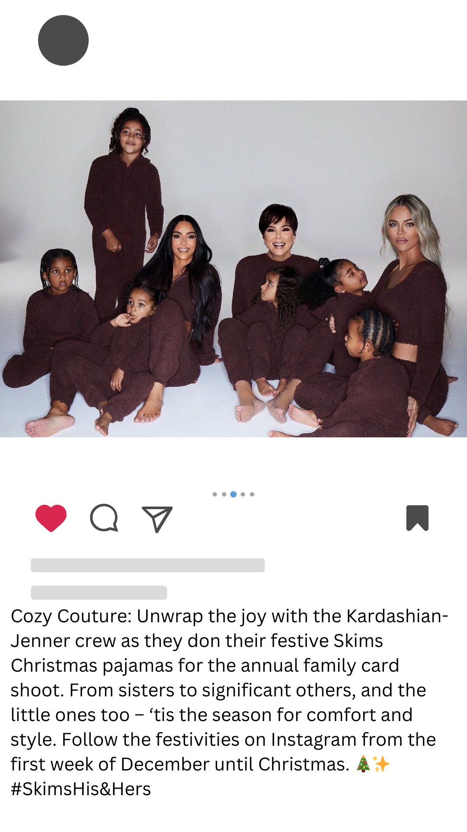
SKIMS & HERS
Objective: Increase customer activity around holiday season, for both genders and break into kids products
Campaign Hashtag: #Skims&Hers
Annual Instagram Christmas Card
Start Date: ~Dec. 1- Dec. 25
Content: Use the annual family Christmas card and implement a new line of kids Christmas pajamas, as well as men and womens pajamas being worn by the Kardashians in the shoot.
Execution:
Each Kardashian will post BTS and finalized photos of the shoot with the accompanying hashtag.
Consumers post their own “Christmas card” in Skims with #Skims&Hers
Break into family audiences
Leverage Holiday
Emphasize loungewear sector of the brand
8/14
Notes:
Ellie

Slide 9
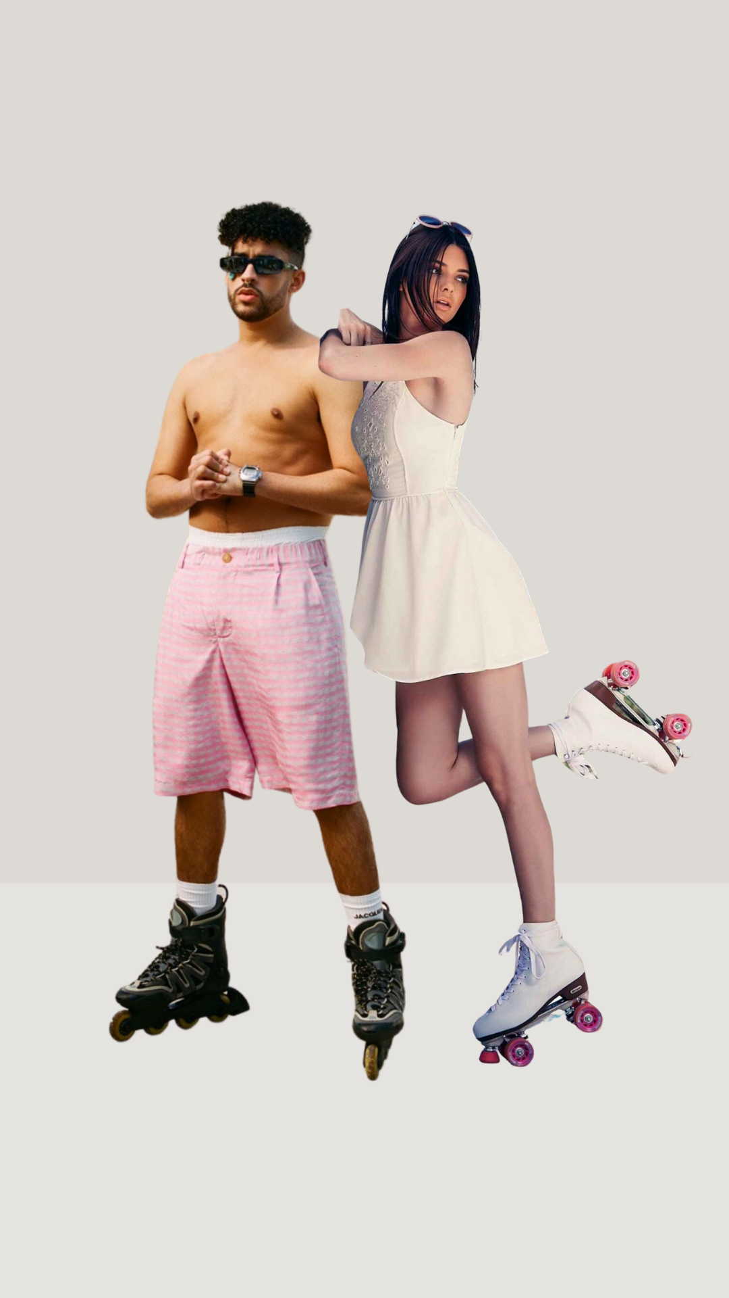
BAD BUNNY & KENDALL JENNER FOR SKIMS
Objective: Increase general interest around Skims
Campaign Hashtag: #SkimadBunnyandSkimdall
Start Date: Second week of February prior to Bad Bunny’s 2024 tour and Milan fashion week
Content:
Visually stunning video commercial, social media engagement, influencer partnerships, and exclusive pop-up shops of the limited edition line
Execution:
Campaign will take place on Skims social media platforms and website
Influencers will post content wearing Skims on their accounts
Kendall Jenner and Bad Bunny will post behind the scenes as they prepare for fashion week and tour in Skims
9/14
Notes:
Lexi

Slide 10
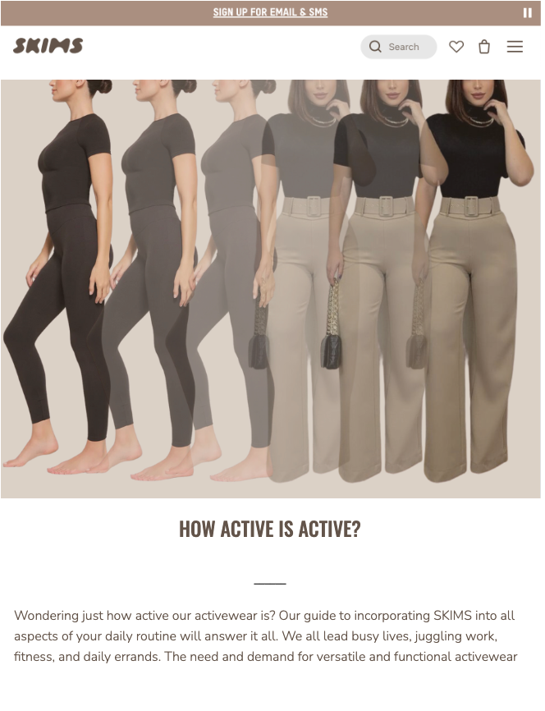
SEAMLESS IN SKIMS
Objective: Leverage UGC to increase awareness, engagement, and trust in the company.
Campaign Hashtag: #SeamlessInSkims
TikTok transition trend with sound
Start Date: January 2024 for 4 weeks to kickstart the new year in Skims
Content: Customers make a transition video of them wearing their Skims throughout their day, from the office to the gym.
Execution: Post an announcement on all platforms about the campaign and incentive.
Introduce the campaign on Skims accounts (Instagram, TikTok, Snap, Twitter, Website) the week before
Participants must use the hashtag #SeemlessInSkims and post on tiktok to a specific song in order to enter.
Incentive: the top 10 most liked posts winning a Skims gift basket
10/14
Notes:
Bridget

Slide 11
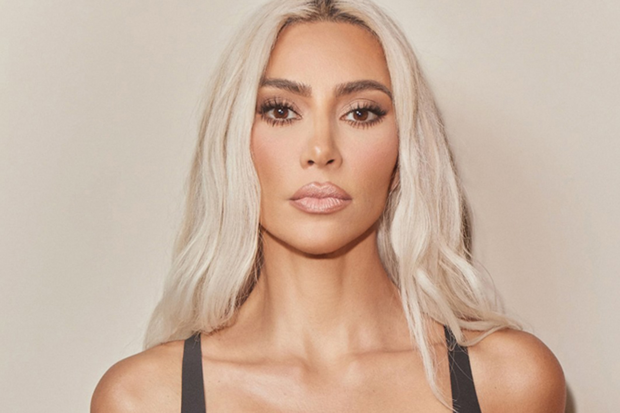
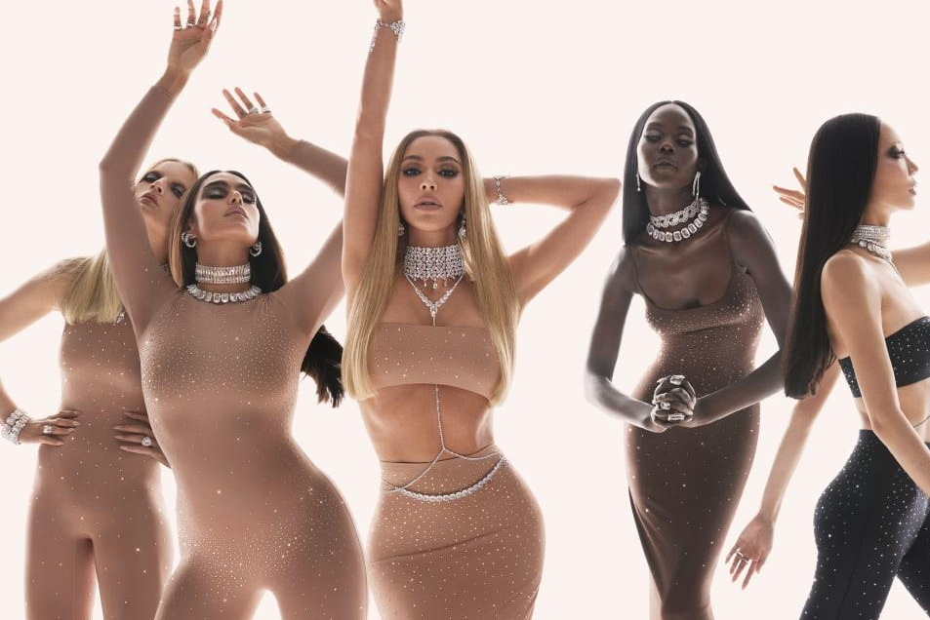
WHAT WE LEARNED
The “Face of the Company”
Limited-Edition Offerings for Exclusivity
Diversity in Product Lines & Target Audiences
Direct association of a celebrity as the “face” of the brand lean into celebrity reputation; potentially affecting brand negatively
Introducing limited-edition product lines tied to celebrity styles can create a sense of exclusivity, driving both sales and heightened brand interest
Skims effectively diversifies its product lines (bridal, athletic, mens) to cater to a wide range of customer interests and needs
11/14
Notes:
Bridget

Slide 12
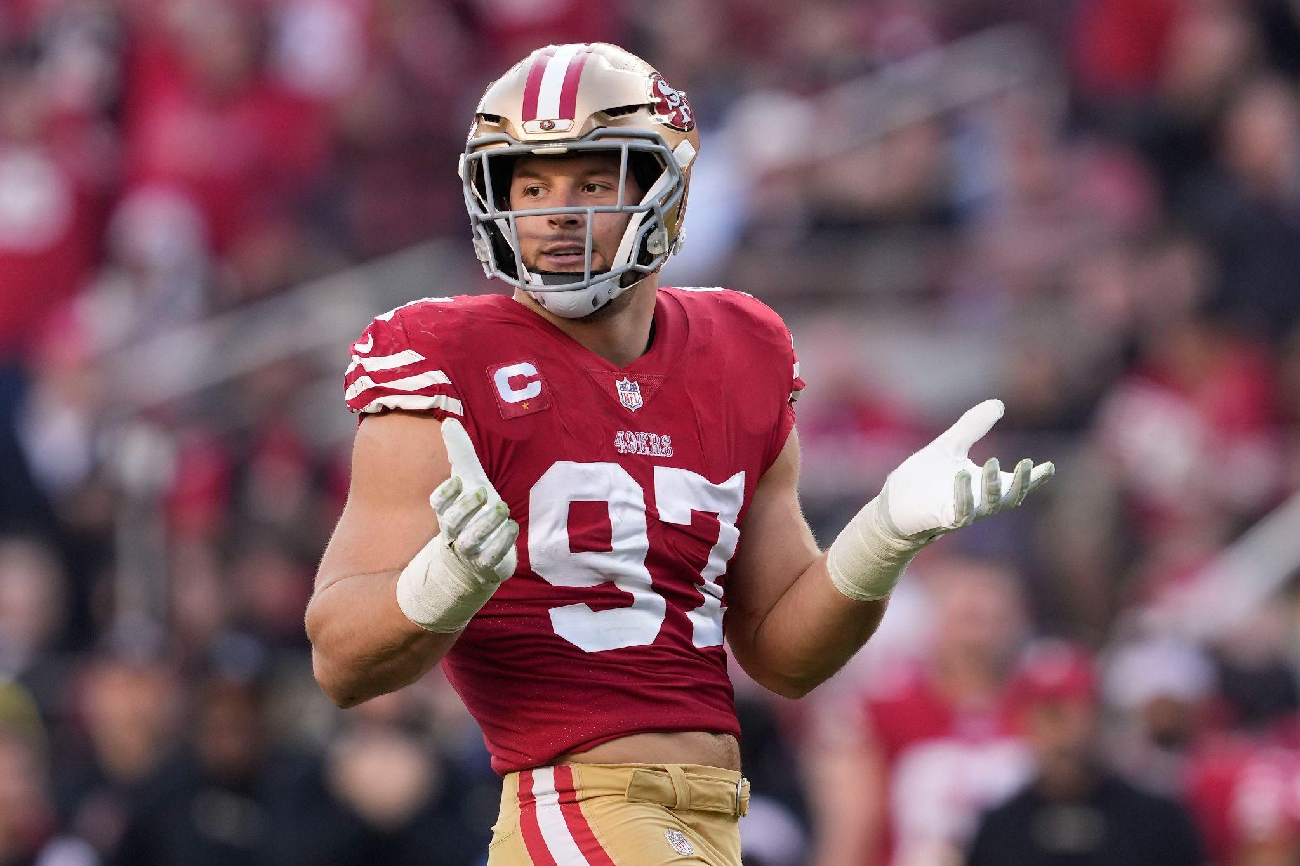
FUTURE DIRECTIONS
Advancing Men’s Line
Global Expansion Strategies:
Increased focus on the development of the Men’s line
Athleisure Line
Expand partnerships with male athletes and influencers
Targeted advertising in different regions of the world to grow international customer base.
Partner with foreign influencers and celebrities to increase brand awareness in overseas markets.
12/14
Notes:
Ali

Slide 13
CONCLUSION
5 Campaign Ideas:
SKIMLYMPICS
SKIMS BRIDE
SKIMS & HERS
BAD BUNNY & KENDALL JENNER
SEAMLESS IN SKIMS
13/14
Notes:
Ashley
Once again these are our 5 campaign ideas.
Overall we believe SKIMS can strengthened their online presence by replying to comments, diving deeper into tiktok and utilizing snapchat. In addition, advancing into a mens line and enhancing the already existing lines. While doing this presentation we learned that kim being the face of the company an affect the skims negatively and positively. As of right now she is positively affecting the company but there is no guarantee it will continue to be positive in the future.

Slide 14
THANK YOU!
QUESTIONS?
14/14

